Slide 1
Sales Analysis Report
By- Kumari Aparna

Slide 2
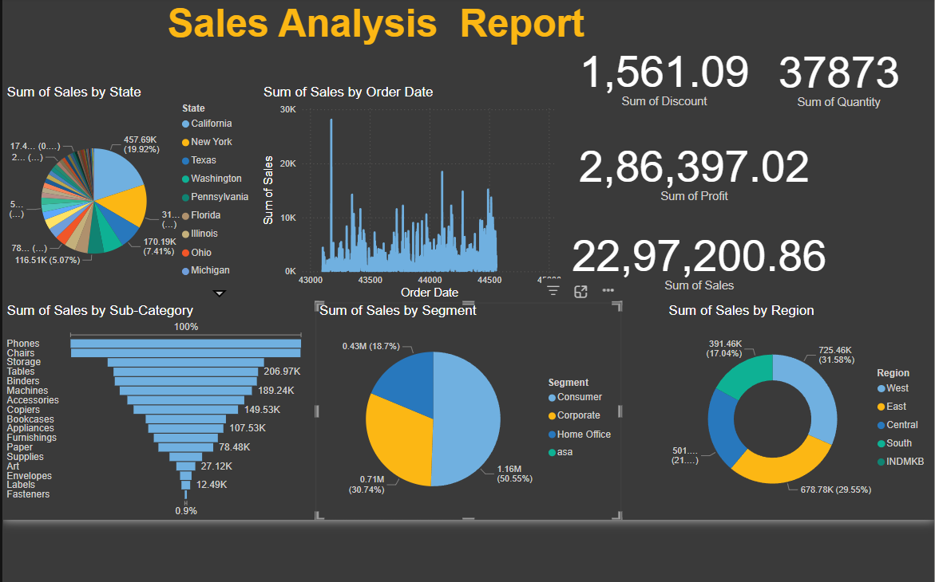

Slide 3
SUMMARY
overview | total
Discount | 1,561.09
Quantity Sold | 37,873
Profit | 2,86,397.02
Sales | 22,97,200.86
category | No
Phones | 206.97K
Chairs | 189.24K
Tables | 149.53K
Region | Sales | %
East | 725.46K | 31.55%
West | 678.78K | 29.55%
Central | 501K | 21.81%
south | 391.46K | 17.04%
Customer segment | No ( million) | %
Consumer | 1.16M | 50.55%
Corporate | 0.71M | 30.74%
Home Office | 0.43M | 18.7%
Top states | Sales | %
California | 457.69K | 19.92%
New York | 310.77K | 13.51%
Texas: | 170.97K | 7.41%)
Insights & Recommendations
California and New York are the leading states for sales.
Phones and Chairs are the highest-selling sub-categories.
Consumer segment and East region drive the majority of sales.
Consider focusing marketing efforts on top-performing states, segments, and sub-categories for maximum impact.

Slide 4
THANK YOU

